Slide 1
SHARPENING FILTERS

Slide 2
UNSHARP MASKING AND HIGHBOOST FILTERING
Subtracting an unsharp (smoothed) version of an image from the original image is process that has been used since the 1930s by the printing and publishing industry to sharpen images.
Steps involved in unsharp masking:
Blur the original image.
Subtract the blurred image from the original (the resulting difference is called the mask.)
Add the mask to the original.

Slide 3
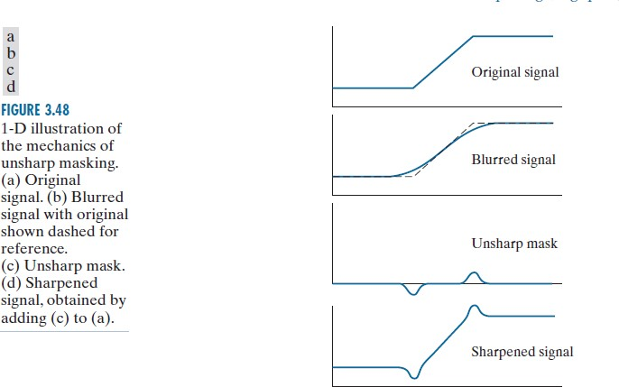
UNSHARP MASKING

Slide 4
UN SHARP MASKING
G_{mask} (x,y) = f(x,y) – f_{lp} (x,y)
High Boost Filtering
F_{hb} (x,y) = A. (G_{mask} (x,y) or unsharp mask)
F_{hb} (x,y) = A. (f(x,y) – f_{lp} (x,y))
If A=0 → Laplacian
filter
If A=1 → Sharpened filter
If A>1 → High boost filter
0 | -1 | 0
-1 | A+4 | -1
0 | -1 | 0

Slide 5
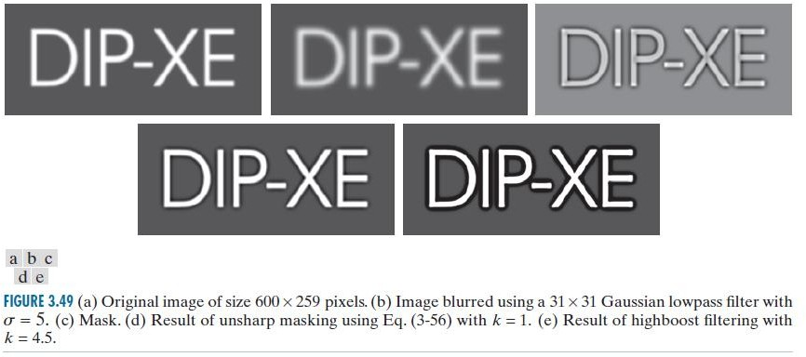

UN SHARP MASKING AND HIGH BOOST FILTERING
Images taken from Gonzalez & Woods, Digital Image Processing

Slide 6
THANK YOU

